Slide 1

RESTAURANTS IN HONG KONG
An analysis to hong kong restaurants

Slide 2
BACKGROUND
Hong Kong is a financial center, a special administrative region and with a population of over 8 million people. It is a crowded city and congested. And undoubtedly there are many choices for accommodation. However, a majority of land in Hong Kong are nature, only less than 10% is residential or so-called city area. Perhaps you've never seen so many mountains in your life and you decided to reserve some time for mountains. There are three main region, HK island, New Territories and Kowloon.
Hong Kong is a food paradise due to its multicultural characteristics. Hong Kong is already really crowded, that means there are restaurants everywhere, perhaps too much and too confusing. Yet you want to let the statistics decide for you.

Slide 3
PROBLEM BACKGROUND
Hong Kong is a financial center, a special administrative region and with a population of over 8 million people. It is a crowded city and congested. And undoubtedly there are many choices for accommodation. However, most of the land in Hong Kong are nature, only less than 10% is residential or so-called city area. Perhaps you've never seen so many mountains in your life and you decided to reserve some time for mountains. There are three main region, HK island, New Territories and Kowloon.
Hong Kong is a food paradise due to its multicultural characteristics. Hong Kong is already really crowded, that means there are restaurants everywhere, perhaps too much and too confusing. Yet you want to let the statistics decide for you.

Slide 4
PROBLEM DESCRIPTION
Suppose I travel and keep changing places very frequently. This is very hectic and plus I get to experience very different types of environment, of which I do not have much knowledge about. In such situation, food can be an important factor for decided how you rate your trips and plus also recommending it to the people. Food can also attract people around to world to try it out if it were to be the best. In such scenarios, we need to find the right place, at reasonable cost, to serve us the best possible way. So, there are few questions that must be addressed, such as
How many types of foods are available in the restaurant? which is the nearest to me with good rating? How many "similar" restaurants are available nearby? Do the "similar" restaurants cost more? if so, what specialty do that have?

Slide 5
TARGET AUDIENCE
Target audiences for this project does not limit to a person who keeps travelling but everyone. People could simply decide to look for a similar restaurant all the time because they are addicted to a specific category of food. People who rarely use restaurants would prefer the most rated restaurants nearby them and all this could be easily handled by our recommender system. So, target for this project is basically everyone who is exploring different places or similar places.

Slide 6
SUCCESS RATE
With restaurants evolving, new food categories emerge, hybrid food starts to be more popular, we need a system that could help us access vast number of food varieties. It is impossible for a person to ask each one about their visit to a place and not everyone remembers everything. On the other hand, Computers are good at remembering things, and with Machine learning to its peak, it high time technology will by our personal guidance and help us personally based on our likes and dislikes. So, people would care about this project as their personal assistance and success rate could certainly increase with time.

Slide 7
DATA REQUIREMENTS
To find a solution to the questions and build a recommender model, we need data and lots of data. Data can answer question which are unimaginable and non-answerable by humans because humans do not have the tendency to analyze such large dataset and produce analytics to find a solution.

Slide 8
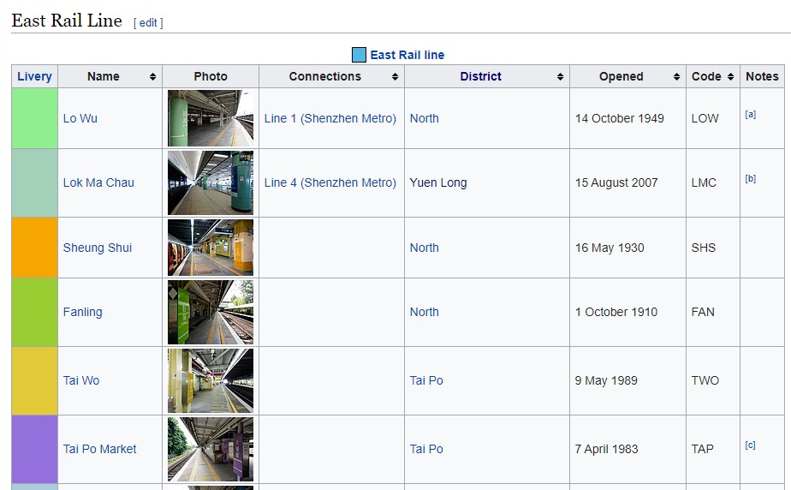
DATA COLLECTION

Slide 9
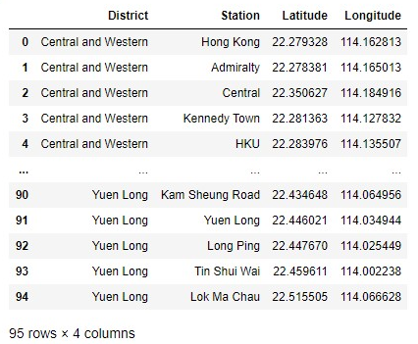
Data acquisition
Beautiful Soup is used to captured to table and remove some elements

Slide 10
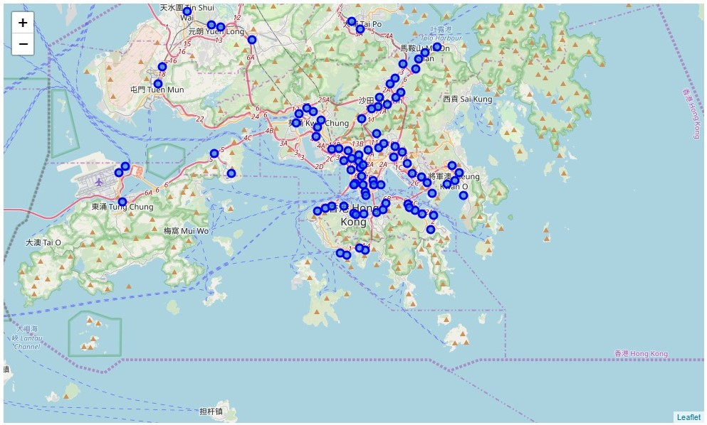
Maps

Slide 11
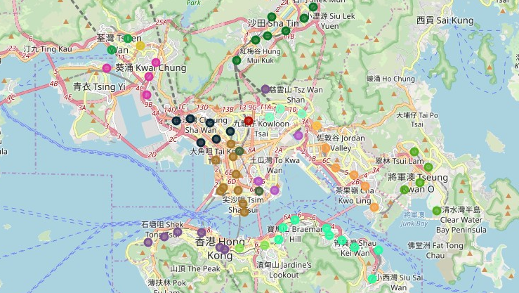

Slide 12
EXPLORE NEIGHBORHOOD
I added the suffix after each station name to ensure the result returned are the station. For example, there is a station named exactly same as Hong Kong, if I don’t add Hong Kong Station, the results will return all the restaurants thus giving an inaccurate result.

Slide 13
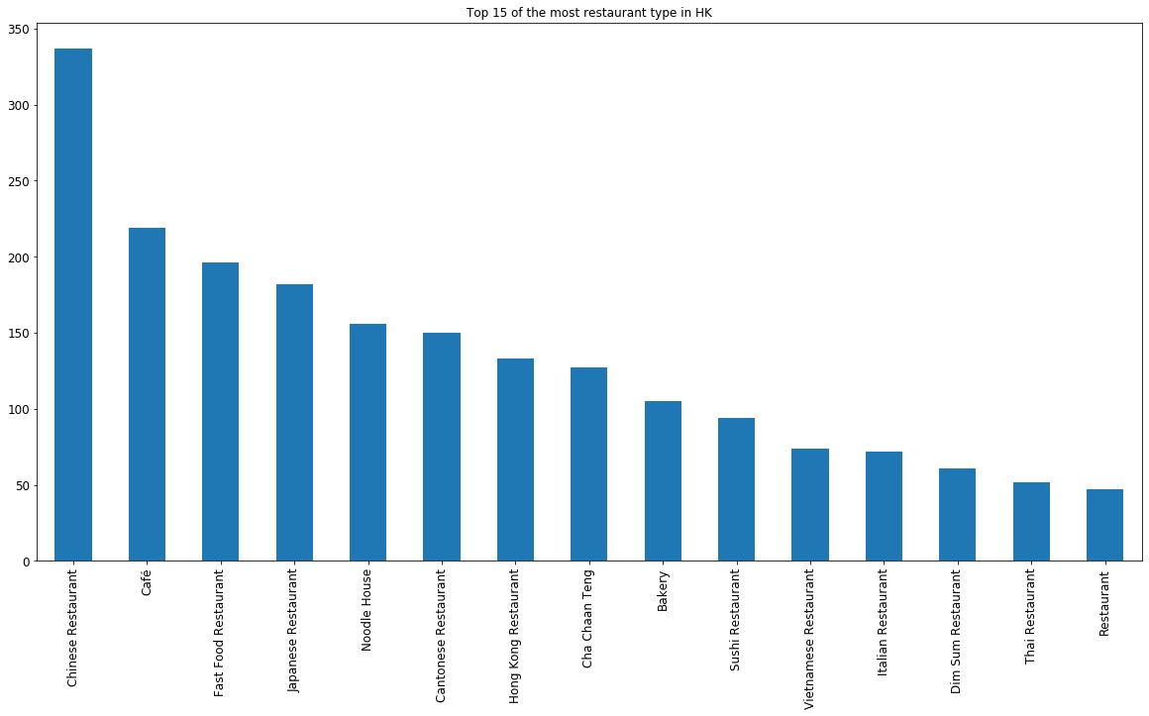
MOST POPULAR TYPE OF RESTAURANTS
Traditional Chinese restaurants outnumber others by a significant portion, some of those type care repeated.

Slide 14
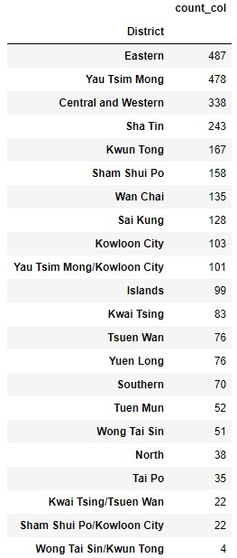
TOTAL RESTAURANTS IN DISTRICTS
Eastern district seems to have the most restaurants results. Let’s further analyze the eastern district.

Slide 15
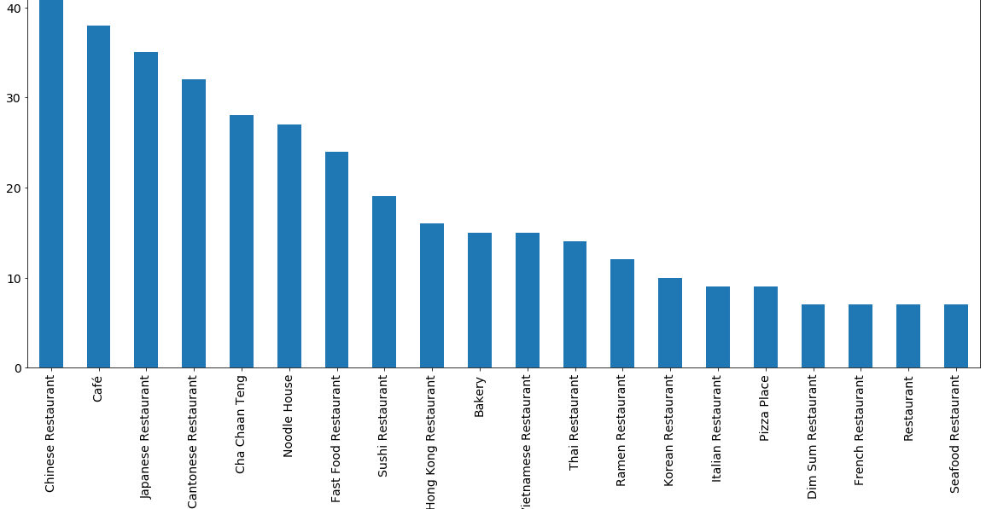

Slide 16
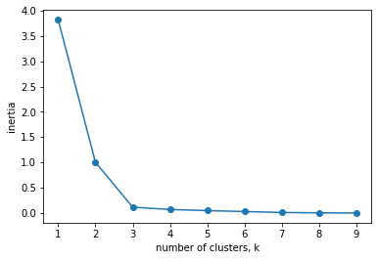
CLUSTERING
First, we need to find out the best k number to do the k-means clustering. An iterative test for inertia of the number of clusters is plotted.

Slide 17
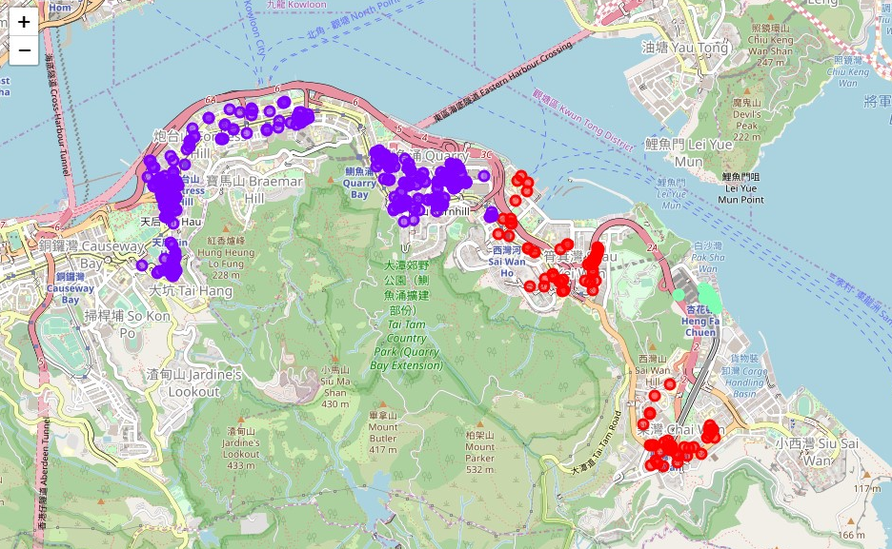
CONCLUSION
After clustering, the restaurants can be seen as the above clusters. The cluster containing the least number is actually the richest neighborhood, maybe that concludes their different restaurant preference.
It seems that nearby neighborhoods have similar eating preference, and somehow a small cluster is found because of their unique preference. Well, the rich people in Hong Kong can keep their eating habits.

